Slide 1
Gobierno Electrónico: Oportunidades con los Datos de las Redes Sociales
Lorena Recalde
Universidad Técnica de Manabí - Ecuador

Slide 2

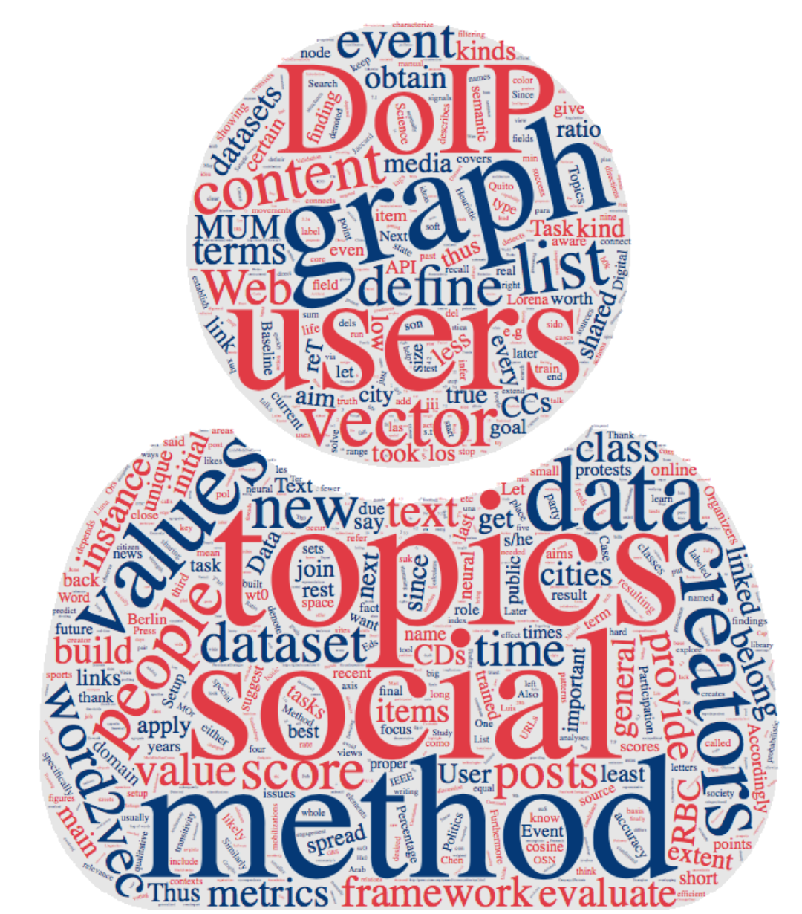
Un poco sobre mi background
Ciudadanía Digital en las Redes Sociales
Modelamiento de las tendencias políticas de los usuarios de Twitter
Mal uso de hashtags relacionados a temas políticos
Mujeres en la política: Argentina, elecciones 2017
Notes:
https://www.ncronline.org/blogs/just-catholic/globalization-technocratic-paradigm

Slide 3



Un poco sobre mi background
Planificación Urbana Cognitiva
Citizens as sensors is a new paradigm that transforms the idea of efficiency implemented in a “Smart City” into the notion of resilience implemented in a “Cognitive City”.
Notes:
https://www.ncronline.org/blogs/just-catholic/globalization-technocratic-paradigm

Slide 4
El Rol de las Redes Sociales
en nuestras vidas
Notes:
Role of OSNs in citizens’ identity: Twitter, Facebook and other platforms
Applications and benefits for government and society
Use of Social Media Data for E-Government and E-Democracy: real scenarios
The impact of OSNs in civic engagement, democratic participation, political party supporters interaction and voting is evident in recent years. People enjoy using Internet and may benefit from it through the opportunity it offers of letting them participate fully in society.

Slide 5
Red Social
Espacio virtual donde las personas se “reúnen” con otras.
Diversas estructuras: grupos pequeños con un fin específico (como tejer); o sitios con millones de participantes.
Varios tipos de plataformas: listas de email, blogs, wikis, and sitios de networking.
Característica común: interacciones entre los usuarios que perduran durante el tiempo.
Intercambio de Información
Juegos Online
Recursos que se comparten
Aprendizaje Colectivo
Conversaciones
Nuevo Contenido
Discubrimiento de contactos sociales
Interacción simultánea
Notes:
By “ online communities ”we mean any virtual space where people come together with others to converse, exchange information or other resources, learn, play, or just be with each other. The term applies to many social configurations, from small close-knit groups to sites with millions of participants. Online communities may be supported by a wide variety of technology platforms, from email lists to forums, blogs, wikis, and networking sites. The common feature is ongoing interactions among people over time, with some of the interactions being technology mediated.

Slide 6
OSNs y algunas estadísticas
En 2009, las redes sociales rebasaron al correo electrónico como la actividad en línea más popular (Nielsen Online report)
En 2017, el 71% de usuarios de internet visitaron y participaron en OSNs y blogs
Aproximadamente el 30% del tiempo que uno pasa online está destinado al uso de las redes sociales
Facebook lidera el mercado con 1.86 billones usuarios activos cada mes
www.statista.com
www.socialmediatoday.com/marketing/how-much-time-do-people-spend-social-media-infographic
Notes:
These statistics suggest that OSNs have become a fundamental part of the global online experience.
Social networking is one of the most popular online activities with high user engagement rates

Slide 7
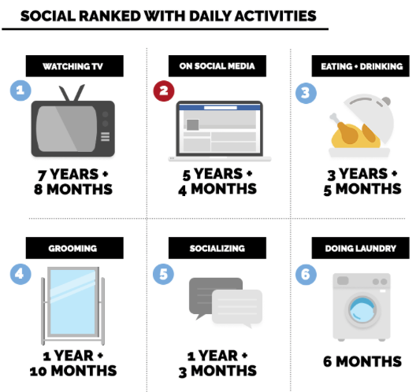
Las Redes Sociales, ¿cuán importantes son?
Una persona promedio dedica aproximadamente 116 minutos al día para navegar en las Redes Sociales.
5 años, 4 meses de nuestras vidas…
www.socialmediatoday.com/marketing/how-much-time-do-people-spend-social-media-infographic
Notes:
time spent on social is only expected to increase as platforms develop,
Right now, the average person will spend 7 years and 8 months watching TV in a lifetime
Currently, total time spent on social media beats time spent eating and drinking, socializing, and grooming.

Slide 8
El Rol de las Redes Sociales
en la Identidad de los Ciudadanos
Notes:
Role of OSNs in citizens’ identity: Twitter, Facebook and other platforms
Applications and benefits for government and society
Use of Social Media Data for E-Government and E-Democracy: real scenarios
The impact of OSNs in civic engagement, democratic participation, political party supporters interaction and voting is evident in recent years. People enjoy using Internet and may benefit from it through the opportunity it offers of letting them participate fully in society.

Slide 9
Ciudadanos Digitales son aquellos que…
tienen habilidades para usar la tecnología para obtener información relacionada a asuntos políticos,
participan en la sociedad de manera online,
usan la tecnología frecuentemente,
buscan información online como una forma de complementar su deber cívico,
y usan la tecnología en su medio laboral en búsqueda de ganancias económicas.
K. Mossberger, et al., Digital Citizenship: The Internet, Society, and Participation. 2007.
Notes:
The frequent use of it elicits online participation of individuals in society.
The impact of OSNs in civic engagement, democratic participation, political party supporters interaction and voting is evident in recent years. People enjoy using Internet and may benefit from it through the opportunity it offers of letting them participate fully in society.
To understand the potential and challenges for digital citizenship, we turn to Rogers Smith’s three traditions of citizenship in U.S. history: Lockean liberalism (equality of opportunity), civic republicanism (politics), and ascriptive hierarchy (inequality). These traditions demonstrate how Internet use is integral to citizenship in an information age, and
We find that Internet use increases the likelihood of voting and civic engagement; it also promotes higher incomes for African Americans and Latinos in particular
I assume that most of you use an OSN, linkedIn researchGate, youtube... Instagram,

Slide 10
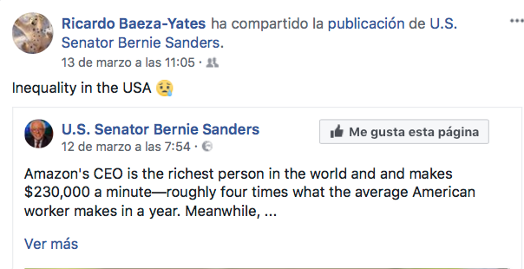

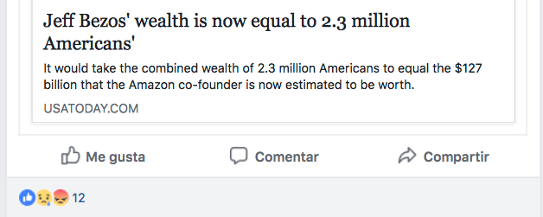
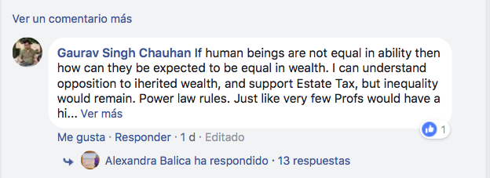
Para los ciudadanos digitales esto significa…
Notes:
Whereas in the pre-internet days, people had to wait for the next newspaper or TV news show to get the latest information, online news is a 24/7 phenomenon.
While you can access news on many websites at any hour, most people spend more time on sites such as Facebook and Twitter than they do on serious news or political websites. This means that you get all of the latest trending news stories and opinions shared by your friends whenever you log on.
people spend more time on sites such as Facebook and Twitter than they do on serious news or political websites.

Slide 11
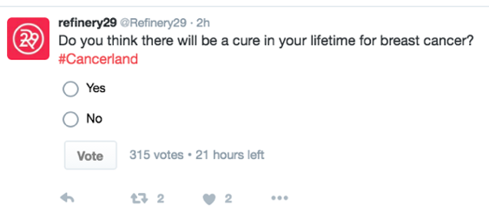
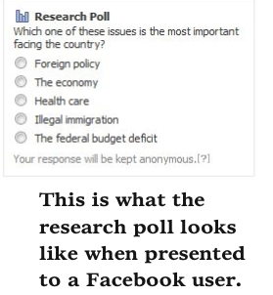
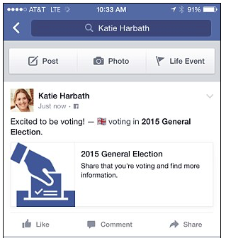
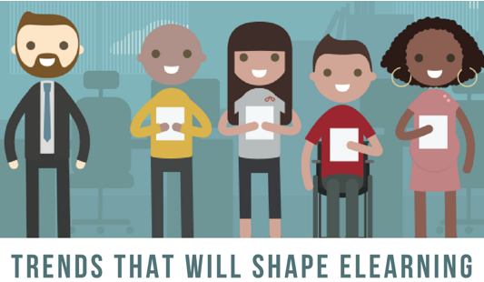
For a digital citizen it means…
Notes:
Facebook, however, may offer hope for a better type of online survey.
The company said: ‘Voters logging on to Facebook this Thursday will see a ‘megaphone’ message at the top of their Facebook News Feed, and will be able to click to share that they are voting with their friends.
‘By clicking the button people can highlight their status as a voter to their Facebook friends, without specifying who they voted for.'
Facebook launches 'I'm a voter' button: Tool will let users tell friends they have voted Read more: http://www.dailymail.co.uk/sciencetech/article-3068830/Facebook-launches-m-voter-button-Tool-let-users-tell-friends-voted-UK-General-Election.html#ixzz59q1cPTjx Follow us: @MailOnline on Twitter | DailyMail on Facebook Read more: http://www.dailymail.co.uk/sciencetech/article-3068830/Facebook-launches-m-voter-button-Tool-let-users-tell-friends-voted-UK-General-Election.html#ixzz59q1LnPUt Follow us: @MailOnline on Twitter | DailyMail on Facebook

Slide 12
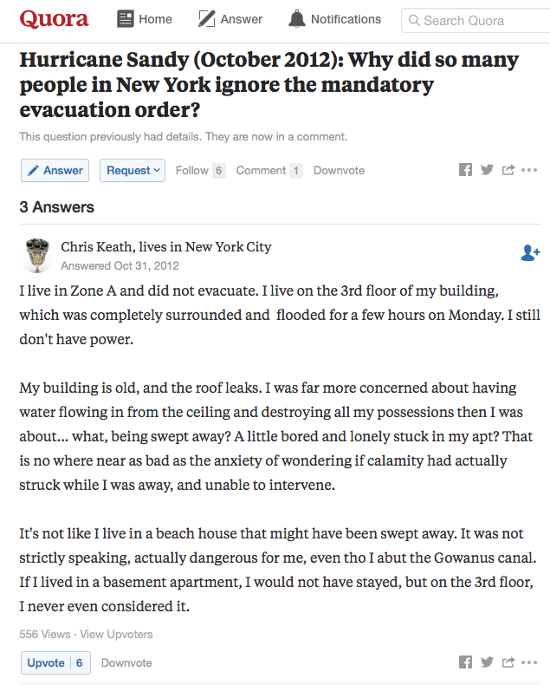
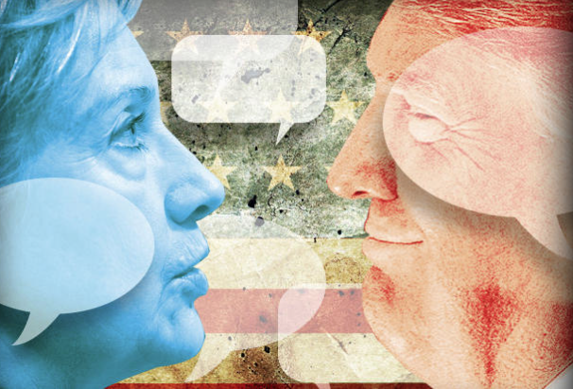
Para los ciudadanos digitales esto significa…
Notes:
Direct Interaction With Politicians. Candidates and their supporters constantly post their views on Facebook and Twitter. Each party has its own pages, from which it broadcasts propaganda and requests for donations.
One of the positive effects that social media has on politics is the opportunity for voters to interact more easily with candidates and elected officials. Traditionally, if you wanted to meet a politician or candidate, you’d have to attend a live event. Not everyone is able to do this. With modern technology, it’s now possible to attend virtual events where you can participate in live streaming events and interact with politicians and candidates.
Reputation of members in the community – vote for quality answers

Slide 13
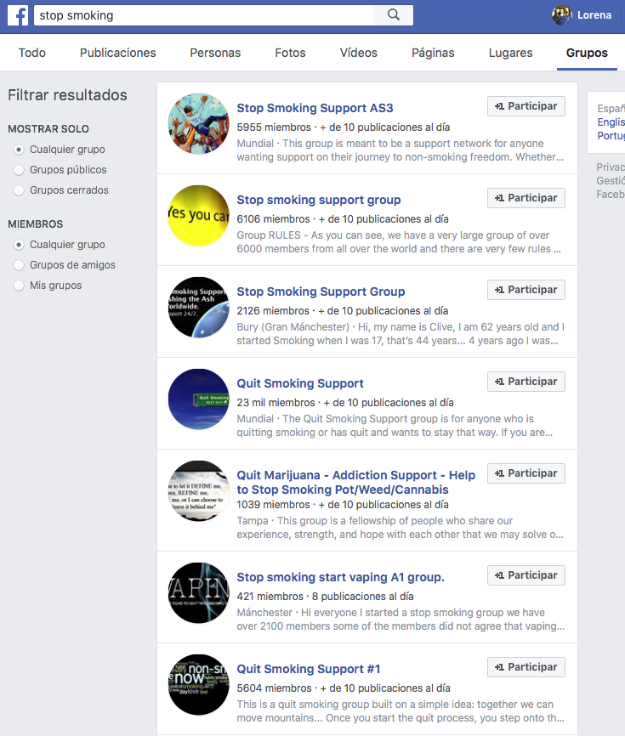
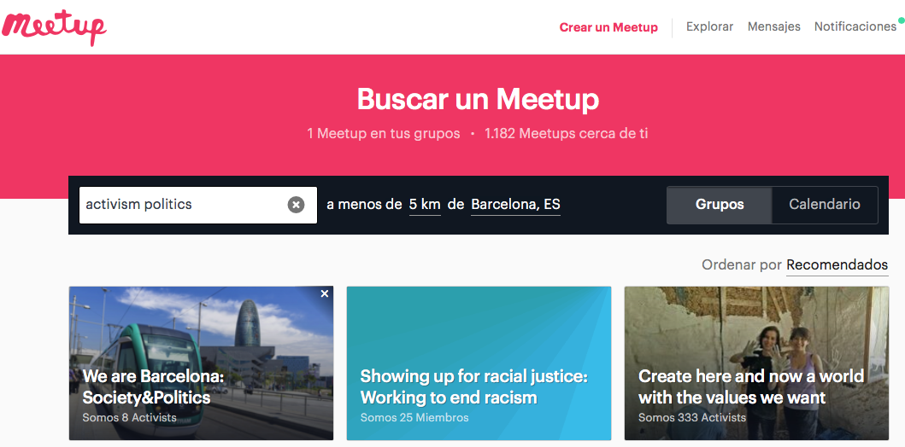
Para los ciudadanos digitales esto significa…

Slide 14
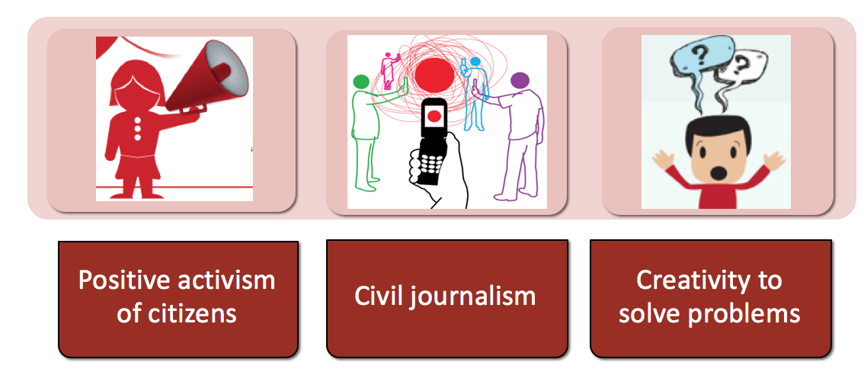
Aplicaciones y beneficios para el gobierno y la sociedad
Temas de interés: educación, bienestar, empleo, medio ambiente e impuestos
Notes:
The use of social media for e-government allows
People have access to the services and get the information that they need in real time.
But there are higher citizens’ expectations and needs.
There are groups of citizens creative enough to help governments to solve problems
Cresumers: Provide clues for solving critical social issues which the government haven’t been able to resolve using its own methods. Cresumers actively engage in social activities
Cresumers create new values based on their personalities and creativity, solutions for difficult social issues
With the rising use of social media and citizen journalism, even some professional journalists are feeling pressure to access a crisis and get out the current event firstly. It is a fact that, eyewitnesses see the correct facts and they are able to get their story out through Twitter, Facebook and other social media outlets. Being timeliness is a major advantage of the street journalism, because “recent events have higher news value than earlier happenings. “ Citizen journalism sites (social media and blogs) are generally timely and they are always updated when an event strikes. Therefore in today’s world, people have high expectations for timeliness when they read news. The web establishes its own advantages of speed and timeliness more and more.
Independence is another golden rule of the citizen journalism. The social media gives average people the ability to transfer information globally and independently. Citizen journalism contains also freedoms of speech. When a story appears online, readers can post more information or even their feelings about the news that is not covered in the original story. Citizen journalists are fully independent and not traditional.

Slide 15
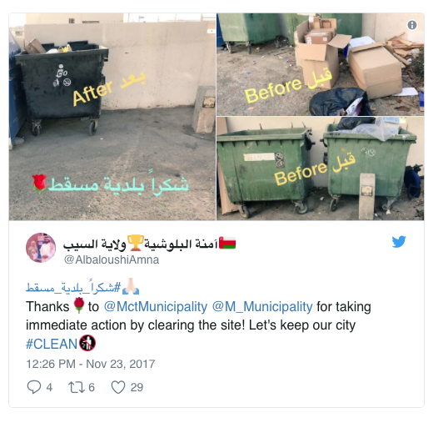
Beneficios
Nueva sociedad convergente altamente conectada.
Servicio gubernamental más amigable y eficiente.
Mayor confort y comodidad.
Los gobiernos pueden responder a situaciones de forma más inteligente y rápida
El Internet tiene el potencial de beneficiar a la sociedad en su conjunto y facilitar la participación de los individuos dentro de la sociedad.
La ciudadanía digital fomenta lo que en otros lugares se ha llamado inclusión social (Warschauer 2003).

Slide 16
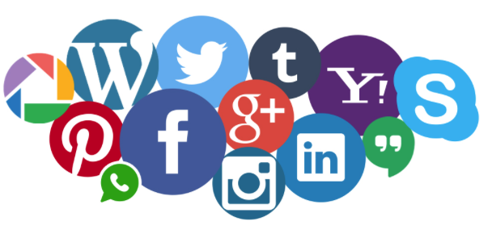
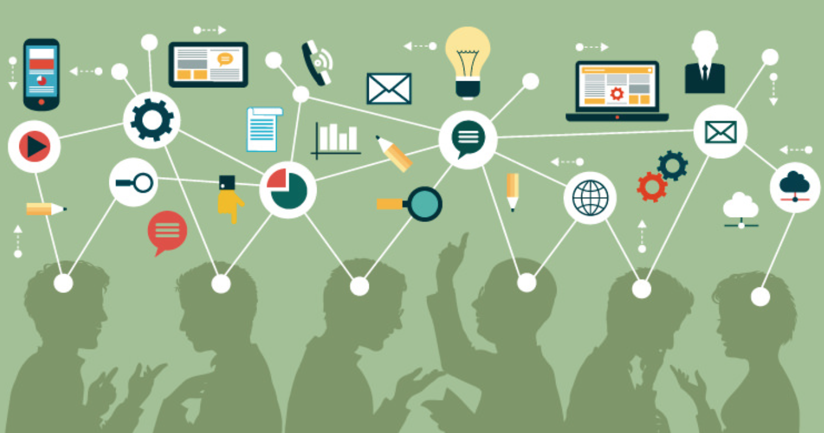
Usuarios generan y comparten contenido,
colaboran en comunidades,
ofrecen feedback,
añaden opiniones,
y crean perfiles personales
No hay barreras de tiempo ni límites de espacio
Notes:
Online communities serve the same range of purposes that offline groups, networks, and communities serve.
They provide their members with opportunities for information sharing and learning, for companionship and social support, and for entertainment.
The promise of online communities is that they break the barriers of time, space, and scale that limit offline interactions. People with unusual medical conditions can get social support from others who share their condition but live far away, and they can do so whenever they need it rather than only at a weekly or monthly scheduled meeting. On Ravelry, knitters can share patterns with thousands more people than they could stitch with in person.
Generated content, virtual social connections and involved interactions have shown to be useful for creating new ways of extracting and modeling user’s interests.

Slide 17
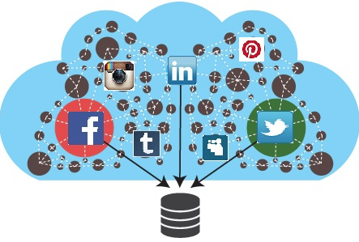
Use de los Datos de las Redes Sociales en E-Government & E-Democracy: Casos de Estudio
Extracción de datos de redes sociales de millones de personas (sin embargo, hay preocupaciones éticas y de privacidad a considerar).
Objetivo: reducir los costos de los programas del gobierno local, agregar valor y mejorar los servicios.
Las innovaciones aprovechan el conocimiento práctico de los empleados públicos con conocimientos digitales para enfrentar desafíos.
Rethinking of traditional ways of delivering public services
Notes:
4 innovations address very different challenges. What they have in common is that each amounts to a rethinking of traditional ways of delivering public services. Governments may never be able to keep up with Silicon Valley in terms of launching the next big thing, but it's a safe bet that they will continue to use these social media platforms -- and whatever the next big thing is -- to create new ways to save money and add value to the services they deliver.
BY STEPHEN GOLDSMITH • FEBRUARY 27, 2017
https://datasmart.ash.harvard.edu/news/article/social-medias-growing-utility-for-government-985

Slide 18
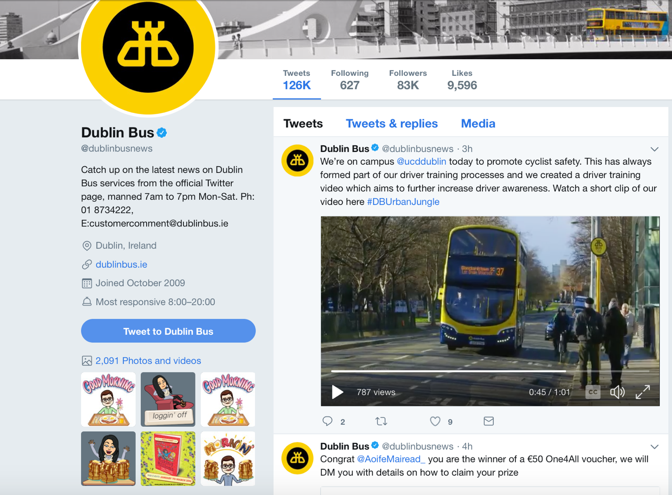
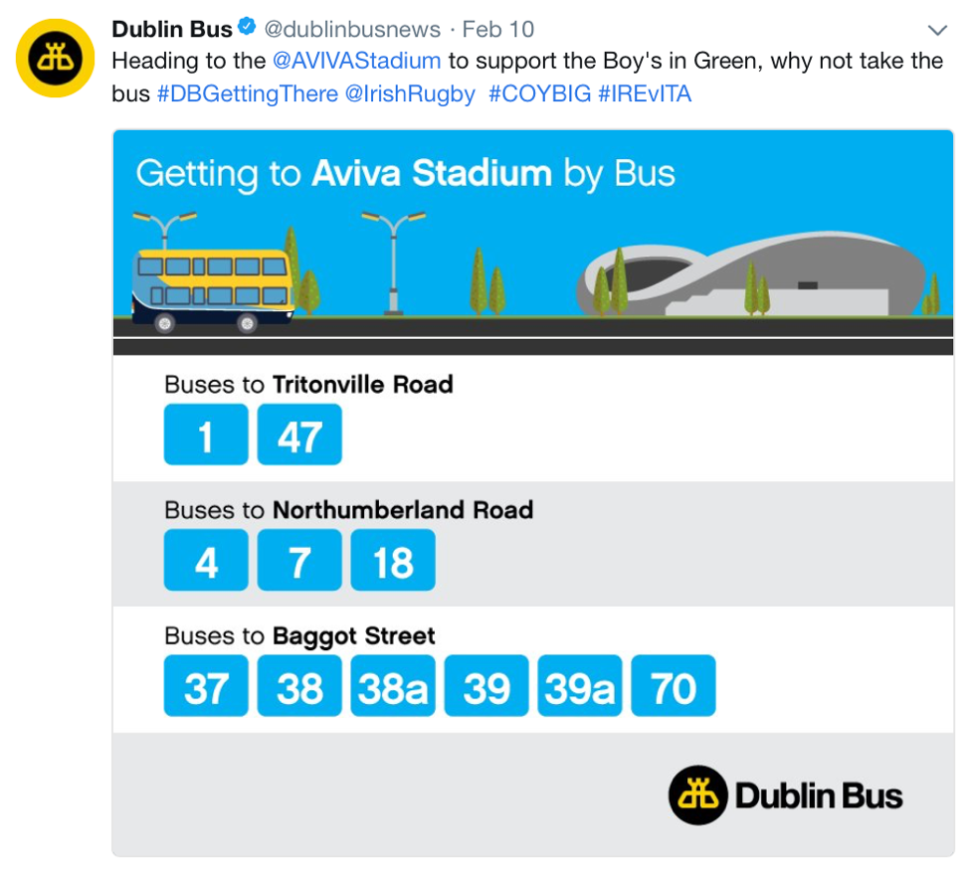
1. Dublin Bus
Información recopilada se usa para gestionar nuevos horarios y rutas de autobuses
Notes:
Not only for users of the service
but for government to use the gathered information to manage new schedules and bus routes

Slide 19
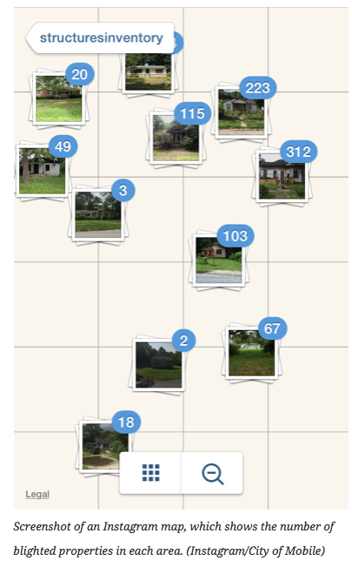
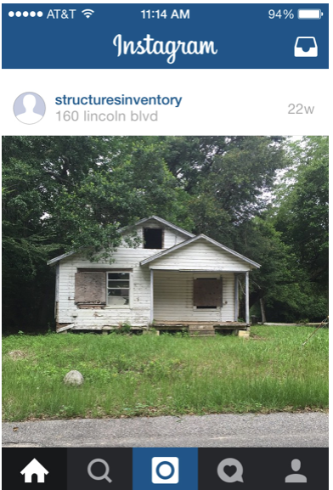
2. Mobile, Alabama
Datos incompletos que se basan únicamente en las quejas de los residentes para identificar propiedades problemáticas
Objetivo: ¿Cuántas propiedades destruidas (en ruinas) hay en la ciudad?
http://www.governing.com/topics/transportation-infrastructure/gov-mobile-alabama-blight-instagram.html
Notes:
Mobile, Ala., faced a growing blight problem compounded by incomplete data that relied only on residents' complaints to identify problem properties. So the city's innovation team turned to Instagram. Relying on the GPS information embedded in photos posted on the site, code-enforcement officers snapped and uploaded pictures of blighted properties to a shared account and then transferred the data to a mapping application to create a visual inventory.
Next, the team combined existing property data, including tax, building permit and ownership status, with the geographic information collected via Instagram. This mapping allowed the team to visualize clusters of blighted properties and commonalities in the existing city data. That made it possible for the city to transition to a proactive model of mitigating blight, saving time and money by capitalizing on technology that city workers were already familiar with from their personal use.

Slide 20
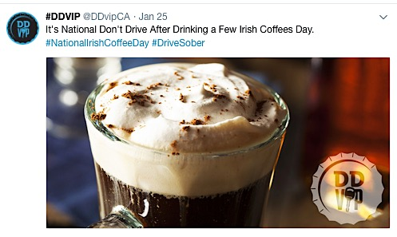
3. Conductor VIP designado
California Office of Traffic Safety
Las redes sociales como una voz amistosa del gobierno en un esfuerzo por reducir la conducción en estado de ebriedad
Cambio del tono moralizador y autoritario
Recompensa a los conductores sobrios con descuentos y ofertas en bares y restaurantes asociados. Eso ayuda a fortalecer los lazos entre el gobierno, las empresas y los consumidores, quienes comparten un interés en fomentar la conducción designada.
Notes:
Across the country, the California Office of Traffic Safety's Designated Drivers VIP campaign turns social media into a friendly voice for government in an effort to reduce drunk driving. OTS wanted to find a way to reconcile the gap between the 20-something drivers it wanted to reach and that population's dislike of the perceived moralizing and authoritative tone that often comes with government campaigns. OTS created a Twitter account without conspicuous government branding at @DDvipCA, utilizing a lighthearted voice to share memes and tweets that tie into current events such as National Irish Coffee Day and the Super Bowl.
The account and its accompanying mobile app reward sober drivers with discounts and deals at partner bars and restaurants, including special nonalcoholic drinks and coupons for food and games. Partner businesses advertise the rewards to their customers, broadcasting DDVIP to a larger audience without substantial advertising expense. That helps to strengthen ties between government, businesses and consumers who all share an interest in encouraging designated driving.

Slide 21
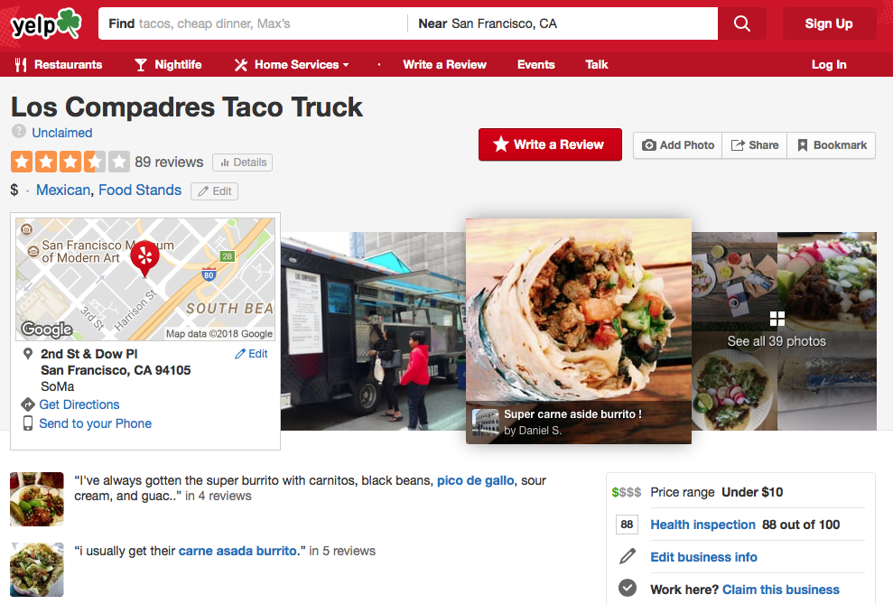
4. Oficina de Seguridad Alimentaria y Saneamiento Wake County, N.C.
Inspecciones a más de 2,600 restaurantes.
¿Cómo difundir la riqueza de datos que se tienen de manera accesible y útil para los consumidores?
El condado se asoció con Yelp para compartir reseñas de negocios locales.
https://www.theatlantic.com/magazine/archive/2013/07/youll-never-throw-up-in-this-town-again/309383/
Notes:
Wake County, N.C.'s Food Safety and Sanitation Office, which conducts sanitation inspections at more than 2,600 restaurants, uses social media to address another problem many governments face: how to widely and effectively disseminate the wealth of data they have in a way that is accessible and useful to consumers.
The agency had been relying on the county website to make restaurant scores available to the public, but it knew that the steps required to access the information were inconvenient and cumbersome. So like several other cities and counties in recent years, it partnered with Yelp, the popular site for sharing reviews of local businesses, in this case to automatically push inspection scores to restaurants' Yelp landing pages. For the county, the only costs associated with this program were the minimal staff hours required to set up data communication with Yelp's servers.
Considering La Palma Mexicatessen in the Mission? It’s got four and a half stars; the chile verde is apparently excellent (thanks, Josh K.); and as of this writing, its most recent health score is 81 out of 100, with inspectors noting, among other violations, a “moderate risk of vermin infestation” on June 6, 2012. More than a dozen cities, including Austin, Philadelphia, and Chicago, are looking at following San Francisco’s lead, some as soon as this year.
Information like this was already available online—San Francisco has been publishing health-inspection scores on a drab government Web site since 2007, while New York City has its own app, called ABCEats. Not surprisingly, diners don’t seem to be going out of their way to look up the data. But when cities make information that’s already technically public really public on a consumer platform, it becomes instantly more visible (to the dismay of some restaurants). Cities have already learned this with public-transportation data: because many transit agencies publish data feeds from their bus and train routes, Google Maps and other applications can plot your trip across Manhattan not just by car, but also by subway. In the future, the same type of data sharing could bring building-code violations to Craigslist, or parking-meter rates to your GPS.
if you're in the right city, you'll also find the restaurant's health inspection score
For the county, the only costs associated with this program were the minimal staff hours required to set up data communication with Yelp's servers.

Slide 22
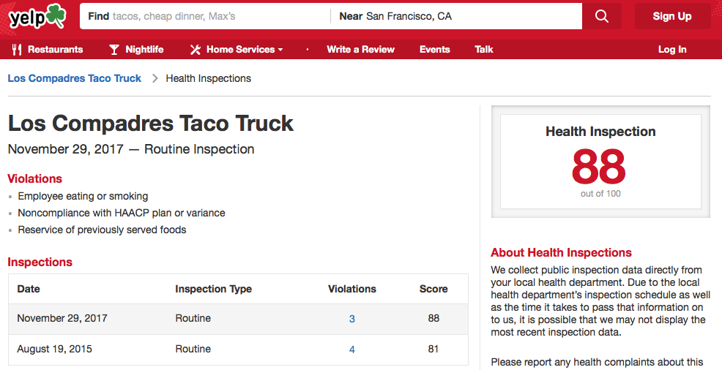
4. Oficina de Seguridad Alimentaria y Saneamiento
Cuando los gobiernos locales hacen que la información (técnicamente pública) sea realmente pública en una plataforma social, se vuelve instantáneamente más visible.
¿Podría una revisión de Yelp ayudar a los inspectores a identificar problemas sanitarios antes de ingresar a un restaurante? Yejin Choi, científico informático de la Universidad de Stony Brook: qué palabras en una revisión de Yelp predicen las malas calificaciones de inspección de salud
Notes:
Yejin Choi, a Stony Brook University computer scientist, he is developing an algorithm that figures out which words in a Yelp review predict bad health-inspection grades (see below). As he puts it, “Some are directly hygiene-related; others are not.” Perhaps in the future, your cranky reviews—“I found a hair in my risotto” or “I spent the night curled around my toilet”—could help health inspectors identify suspect kitchens before even entering them.
Various researchers have already trained algorithms to scan TripAdvisor and Yelp
So far, seven cities and counties in the U.S. have handed their health inspection data to Yelp for use in its listings. "We're eager to bring more cities online this year," says Lowe.
Yelp shows the date of health inspections and the date that any violations are corrected.
Would it decrease decrease in hospitalizations for foodborne illness??

Slide 23
Temas emergentes (Open issues)
Consumo de contenido sesgado de las redes sociales, naive usage of social data…
Alexandra Olteanu, Emre Kıcıman, and Carlos Castillo. 2018. A Critical Review of Online Social Data: Biases, Methodological Pitfalls, and Ethical Boundaries. In Proceedings of the Eleventh ACM International Conference on Web Search and Data Mining (WSDM '18).
Manejo del filter bubble o burbuja de filtro, la ilusión de que "todos" piensan de la misma manera
Tien T. Nguyen, Pik-Mai Hui, F. Maxwell Harper, Loren Terveen, and Joseph A. Konstan. 2014. Exploring the filter bubble: the effect of using recommender systems on content diversity. In Proceedings of the 23rd international conference on World wide web (WWW '14).
Cómo enfrenter las fake news
Allcott, Hunt, and Matthew Gentzkow. 2017. "Social Media and Fake News in the 2016 Election." Journal of Economic Perspectives, 31 (2): 211-36
Inclusión social real de los ciudadanos en el mundo digital

Slide 24
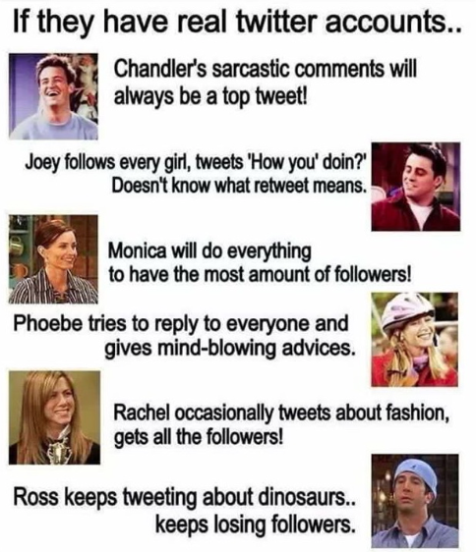
How do you use Twitter? (or other OSNs)
to obtain political information,
to participate in society online,
to search for online information to fulfill your civic duty,
to congratulate/complain about public service
to report failures in the social system
at work to share/get opinions.

Slide 25
https://github.com/lore10
lrecalde10@gmail.com
THANK YOU!

